Slide 1
GAN 期末報告
偉大的恩師
曾龍

Slide 2
CycleGAN
CycleGAN使用周期一致性損失來進行訓練，而無需配對數據。換句話說，它可以從一個域轉換到另一個域，而無需在源域和目標域之間進行一對一映射。
這樣就可以執行許多有趣的任務，例如照片增強，圖像著色，樣式轉換等。您需要的只是源數據集和目標數據集（僅是圖像目錄）。

Slide 3
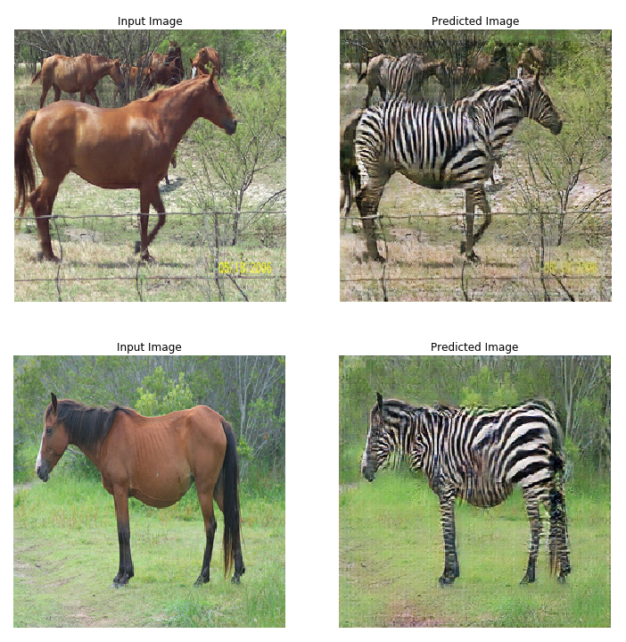
您需要的只是源數據集和目標數據集 （僅是圖像目錄）

Slide 4
設置輸入管道
安裝Tensorflow_examples軟件包
//----------------------------------------------------------------------//
!pip install git+https://github.com/tensorflow/examples.git
import tensorflow as tf
import tensorflow_datasets as tfds
from tensorflow_examples.models.pix2pix import pix2pix import os
import time
import matplotlib.pyplot as plt
from IPython.display import clear_output tfds.disable_progress_bar()
AUTOTUNE = tf.data.experimental.AUTOTUNE

Slide 5
輸入管道
本教程訓練了一個模型，以將馬的圖像轉換為斑馬的圖像。您可以在此處找到該數據集和類似的數據集。
這些是一些避免過度擬合的圖像增強技術。
這類似於在pix2pix中所做的在隨機抖動中，圖像被調整為286 x 286，然後隨機裁剪為256 x 256。
在隨機鏡像中，圖像會水平（即從左到右）隨機翻轉。

Slide 6
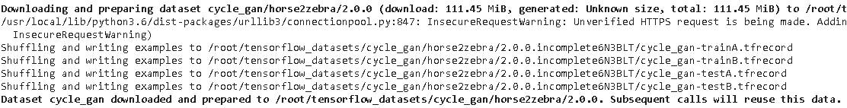
輸入檔案
dataset, metadata = tfds.load('cycle_gan/horse2zebra',with_info=True, as_supervised=True)
train_horses, train_zebras = dataset['trainA'], dataset['trainB']
test_horses, test_zebras = dataset['testA'], dataset['testB']
//---------------讀取檔案-----------------//
//---------------執行後畫面--------------//

Slide 7
BUFFER_SIZE = 1000//大小
BATCH_SIZE = 1 //
IMG_WIDTH = 256 // 長寬
IMG_HEIGHT = 256 //
//-------------------------------------------------//
def random_crop(image): // 讀取圖片
cropped_image = tf.image.random_crop(
image, size=[IMG_HEIGHT, IMG_WIDTH, 3])
return cropped_image
//-----------------------------------------------//
# normalizing the images to [-1, 1]
def normalize(image):
image = tf.cast(image, tf.float32)
image = (image / 127.5) - 1 // 256 pixe/2
return image
//-----------------------------------------------//

Slide 8
def random_jitter(image):
# resizing to 286 x 286 x 3
image = tf.image.resize(image, [286, 286],
method=tf.image.ResizeMethod.NEAREST_NEIGHBOR) # randomly cropping to 256 x 256 x 3
image = random_crop(image) # random mirroring
image = tf.image.random_flip_left_right(image) return image
//---------------------------------------------------------------------------------------//
def preprocess_image_train(image, label):
image = random_jitter(image)
image = normalize(image)
return image
//-----------------------------------------------------------------------------------------//

Slide 9
train_horses = train_horses.map(
preprocess_image_train, num_parallel_calls=AUTOTUNE).cache().shuffle(
BUFFER_SIZE).batch(1)
//-----------------------------------------------------------------------//
train_zebras = train_zebras.map(
preprocess_image_train, num_parallel_calls=AUTOTUNE).cache().shuffle(
BUFFER_SIZE).batch(1)
//------------------------------------------------------------------//
test_horses = test_horses.map(
preprocess_image_test, num_parallel_calls=AUTOTUNE).cache().shuffle(
BUFFER_SIZE).batch(1)
//-------------------------------------------------------------------//
test_zebras = test_zebras.map(
preprocess_image_test, num_parallel_calls=AUTOTUNE).cache().shuffle(
BUFFER_SIZE).batch(1)
//-----------------------------------------------------//

Slide 10
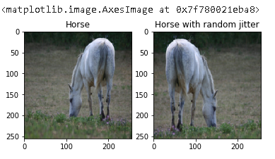
sample_horse = next(iter(train_horses))
sample_zebra = next(iter(train_zebras))
plt.subplot(121)
plt.title('Horse')
plt.imshow(sample_horse[0] * 0.5 + 0.5) plt.subplot(122)
plt.title('Horse with random jitter')
plt.imshow(random_jitter(sample_horse[0]) * 0.5 + 0.5)
//----水平方轉------------180 轉180-----------//
//-------------------------------------------------------------------------------//

Slide 11
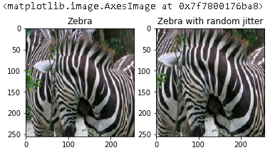
plt.subplot(121)
plt.title('Zebra')
plt.imshow(sample_zebra[0] * 0.5 + 0.5) plt.subplot(122)
plt.title('Zebra with random jitter')
plt.imshow(random_jitter(sample_zebra[0]) * 0.5 + 0.5)

Slide 12
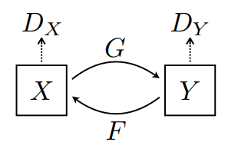
Import and reuse the Pix2Pix models
Cyclegan使用實例規範化而不是批處理規範化。
所述CycleGAN紙使用改進的resnet基於發電機。unet為了簡單起見，本教程使用了經過修改的生成器。
這裡訓練了2個生成器（G和F）和2個鑑別器（X和Y）。
生成器G學習將圖像轉換X為圖像Y。（G ：X- > Y）
生成器F學習將圖像轉換Y為圖像X。（F：Y− > X）
鑑別器D_X學會區分圖像X和生成的圖像X（F(Y)）。
鑑別器D_Y學會區分圖像Y和生成的圖像Y（G(X)）。

Slide 13
OUTPUT_CHANNELS = 3 generator_g = pix2pix.unet_generator(OUTPUT_CHANNELS, norm_type='instancenorm')
generator_f = pix2pix.unet_generator(OUTPUT_CHANNELS, norm_type='instancenorm') discriminator_x = pix2pix.discriminator(norm_type='instancenorm', target=False)
discriminator_y = pix2pix.discriminator(norm_type='instancenorm', target=False)

Slide 14
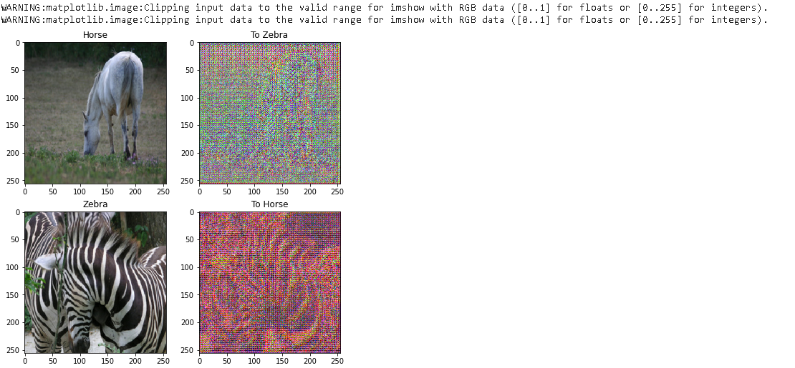
to_zebra = generator_g(sample_horse)
to_horse = generator_f(sample_zebra)
plt.figure(figsize=(8, 8))
contrast = 8
imgs = [sample_horse, to_zebra, sample_zebra, to_horse]
title = ['Horse', 'To Zebra', 'Zebra', 'To Horse']
for i in range(len(imgs)):
plt.subplot(2, 2, i+1)
plt.title(title[i])
if i % 2 == 0:
plt.imshow(imgs[i][0] * 0.5 + 0.5)
else:
plt.imshow(imgs[i][0] * 0.5 * contrast + 0.5)
plt.show()

Slide 15
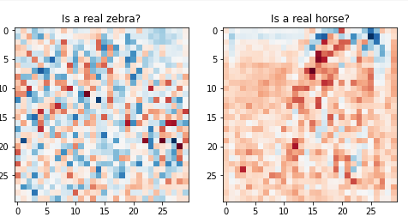
plt.figure(figsize=(8, 8)) plt.subplot(121)
plt.title('Is a real zebra?')
plt.imshow(discriminator_y(sample_zebra)[0, ..., -1], cmap='RdBu_r') plt.subplot(122)
plt.title('Is a real horse?')
plt.imshow(discriminator_x(sample_horse)[0, ..., -1], cmap='RdBu_r') plt.show()

Slide 16
損失函數
沒有要訓練的配對數據，因此不能保證輸入x和目標y對在訓練期間有意義。因此，為了強製網絡學習正確的映射，作者提出了循環一致性損失。
LAMBDA = 10
loss_obj = tf.keras.losses.BinaryCrossentropy(from_logits=True)
def discriminator_loss(real, generated):
real_loss = loss_obj(tf.ones_like(real), real) generated_loss = loss_obj(tf.zeros_like(generated), generated) total_disc_loss = real_loss + generated_loss return total_disc_loss * 0.5
//--------------------------------------------------------------------------//
def generator_loss(generated):
return loss_obj(tf.ones_like(generated), generated)

Slide 17
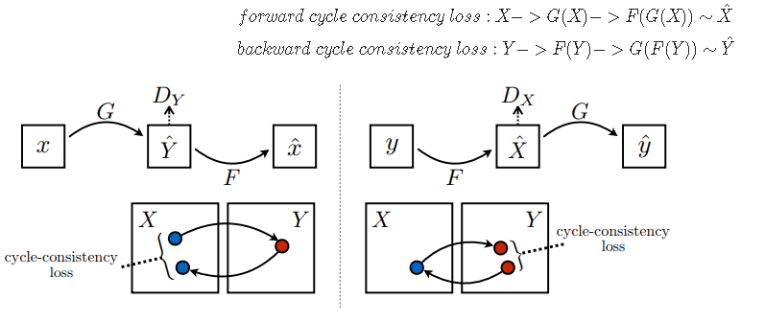
週期一致性意味著結果應接近原始輸入。例如，如果將一個句子從英語翻譯為法語，然後再將其從法語翻譯為英語，則結果句子應與原始句子相同。
在周期一致性損失中，
圖片 X 通過發電機傳遞 G 產生生成的圖像 ÿ^。
生成的圖像 ÿ^ 通過發電機傳遞 F 產生循環圖像 X^。
平均絕對誤差在 X 和 X^。

Slide 18
def calc_cycle_loss(real_image, cycled_image):
loss1 = tf.reduce_mean(tf.abs(real_image - cycled_image))
return LAMBDA * loss1
def identity_loss(real_image, same_image):
loss = tf.reduce_mean(tf.abs(real_image - same_image))
return LAMBDA * 0.5 * loss
//--------------------------------------------------------------------------------------------------------//
generator_g_optimizer = tf.keras.optimizers.Adam(2e-4, beta_1=0.5) // 小W
generator_f_optimizer = tf.keras.optimizers.Adam(2e-4, beta_1=0.5) discriminator_x_optimizer = tf.keras.optimizers.Adam(2e-4, beta_1=0.5)
discriminator_y_optimizer = tf.keras.optimizers.Adam(2e-4, beta_1=0.5)

Slide 19
Checkpoints
checkpoint_path = "./checkpoints/train"
ckpt = tf.train.Checkpoint(generator_g=generator_g,
generator_f=generator_f,
discriminator_x=discriminator_x,
discriminator_y=discriminator_y,
generator_g_optimizer=generator_g_optimizer,
generator_f_optimizer=generator_f_optimizer,
discriminator_x_optimizer=discriminator_x_optimizer,
discriminator_y_optimizer=discriminator_y_optimizer) ckpt_manager = tf.train.CheckpointManager(ckpt, checkpoint_path, max_to_keep=5) # if a checkpoint exists, restore the latest checkpoint.
if ckpt_manager.latest_checkpoint:
ckpt.restore(ckpt_manager.latest_checkpoint)
print ('Latest checkpoint restored!!')

Slide 20
本示例模型的訓練時數少於論文（200）的紀元（40）
EPOCHS = 40//紀元（40）
//--------------------------------------------------//
def generate_images(model, test_input):
prediction = model(test_input)
plt.figure(figsize=(12, 12)) display_list = [test_input[0], prediction[0]]
title = ['Input Image', 'Predicted Image'] for i in range(2):
plt.subplot(1, 2, i+1)
plt.title(title[i])
//-------------------------------------------------//
# getting the pixel values between [0, 1] to plot it.
plt.imshow(display_list[i] * 0.5 + 0.5)
plt.axis('off')
plt.show()

Slide 21
@tf.function
def train_step(real_x, real_y):
# persistent is set to True because the tape is used more than
# once to calculate the gradients.
with tf.GradientTape(persistent=True) as tape:
# Generator G translates X -> Y
# Generator F translates Y -> X.
//--------------------------------------------------------------------------------//
fake_y = generator_g(real_x, training=True)
cycled_x = generator_f(fake_y, training=True)
//--------------------------------------------------------------------------------// fake_x = generator_f(real_y, training=True)
cycled_y = generator_g(fake_x, training=True)
//----------------------------------------------------------------------------------// # same_x and same_y are used for identity loss.
same_x = generator_f(real_x, training=True)
same_y = generator_g(real_y, training=True)
//-------------------------------------------------------------------------------------// disc_real_x = discriminator_x(real_x, training=True)
disc_real_y = discriminator_y(real_y, training=True)
//------------------------------------------------------------------------------------// disc_fake_x = discriminator_x(fake_x, training=True)
disc_fake_y = discriminator_y(fake_y, training=True)
//-------------------------------------------------------------------------------------// # calculate the loss
gen_g_loss = generator_loss(disc_fake_y)
gen_f_loss = generator_loss(disc_fake_x)
//-----------------------------------------------------------------------------------//
total_cycle_loss = calc_cycle_loss(real_x, cycled_x) + calc_cycle_loss(real_y, cycled_y)
//-----------------------------------------------------------------------------------//
# Total generator loss = adversarial loss + cycle loss
total_gen_g_loss = gen_g_loss + total_cycle_loss + identity_loss(real_y, same_y)
total_gen_f_loss = gen_f_loss + total_cycle_loss + identity_loss(real_x, same_x)
//-----------------------------------------------------------------------------------// disc_x_loss = discriminator_loss(disc_real_x, disc_fake_x)
disc_y_loss = discriminator_loss(disc_real_y, disc_fake_y)
即使訓練循環看起來很複雜獲取預測計算損失--

Slide 22
for epoch in range(EPOCHS):
start = time.time()
//--------------------------------------------------------------------------------------------// n = 0
for image_x, image_y in tf.data.Dataset.zip((train_horses, train_zebras)):
train_step(image_x, image_y)
if n % 10 == 0:
print ('.', end='')
n+=1
//--------------------------------------------------------------------------------------------// clear_output(wait=True)
# Using a consistent image (sample_horse) so that the progress of the model
# is clearly visible.
generate_images(generator_g, sample_horse)
//--------------------------------------------------------------------------------------------// if (epoch + 1) % 5 == 0:
ckpt_save_path = ckpt_manager.save()
print ('Saving checkpoint for epoch {} at {}'.format(epoch+1,ckpt_save_path))
//--------------------------------------------------------------------------------------------// print ('Time taken for epoch {} is {} sec\n'.format(epoch + 1, time.time()-start))

Slide 23
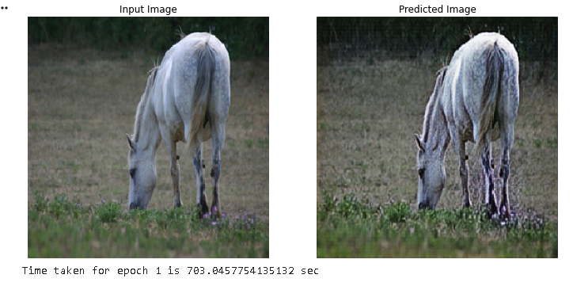
執行畫面 :

Slide 24
# Run the trained model on the test dataset
for inp in test_horses.take(5):
generate_images(generator_g, inp)
//---------------------------------------------//
本教程展示瞭如何從Pix2Pix教程中實現的生成器和鑑別器開始實現CycleGAN。下一步，您可以嘗試使用與TensorFlow數據集不同的數據集。
//-----------------------------------------------------//
您也可以訓練更多的紀元來改善結果，或者可以實現本文中使用的經過修改的ResNet生成器，而不是此處使用的U-Net生成器

Slide 25
參考文獻
https://colab.research.google.com/github/tensorflow/docs/blob/master/site/en/tutorials/generative/cyclegan.ipynb?pli=1#scrollTo=KBKUV2sKXDbY

